Slide 1

Practical solutions for fault-tolerant networks
Project Number : p-2023-012
Supervisors : Prof. Michael Segal
Snir Moscovich – 206293128
Dor Moolay – 205870637

Slide 2
Background
Wireless communication is increasingly being employed to transfer highly sensitive information.
the relational disposition of wireless nodes is constantly changing.
The network's temporary physical topology depends on the distribution of wireless nodes and their transmission ranges.
Limited energy supplies in wireless devices necessitate energy-efficient network design.
Power optimization is crucial in wireless networks to ensure efficient and reliable communication.

Slide 3

The project's main goal
Our main goal is Design algorithms that assign power $a_{v}$ to each node in order to satisfy the following objectives:
Efficient Communication: Establish communication capability between all pairs of nodes within the network.
Minimum Power Consumption: Minimize power usage to optimize energy efficiency.
Battery Life Preservation: Maximize the battery life of wireless devices by effectively managing power allocation.
Specific Objectives: Address desired requirements, such as network diameter, k-edge disjoint paths, or k-node disjoint paths between nodes.

Slide 4
Methodology
Our working method throughout the project is divided into three stages:
design
analyze
simulation
analyze our efficiency of our algorithm compared to the optimal solution on simple topologies.
examine our algorithm on wide and complicated topologies in a simulation tool.
combines several algorithms for solving the power assignment problem.

Slide 5
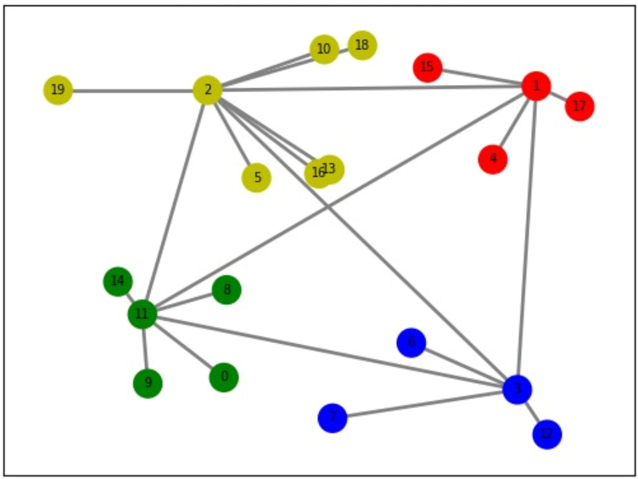
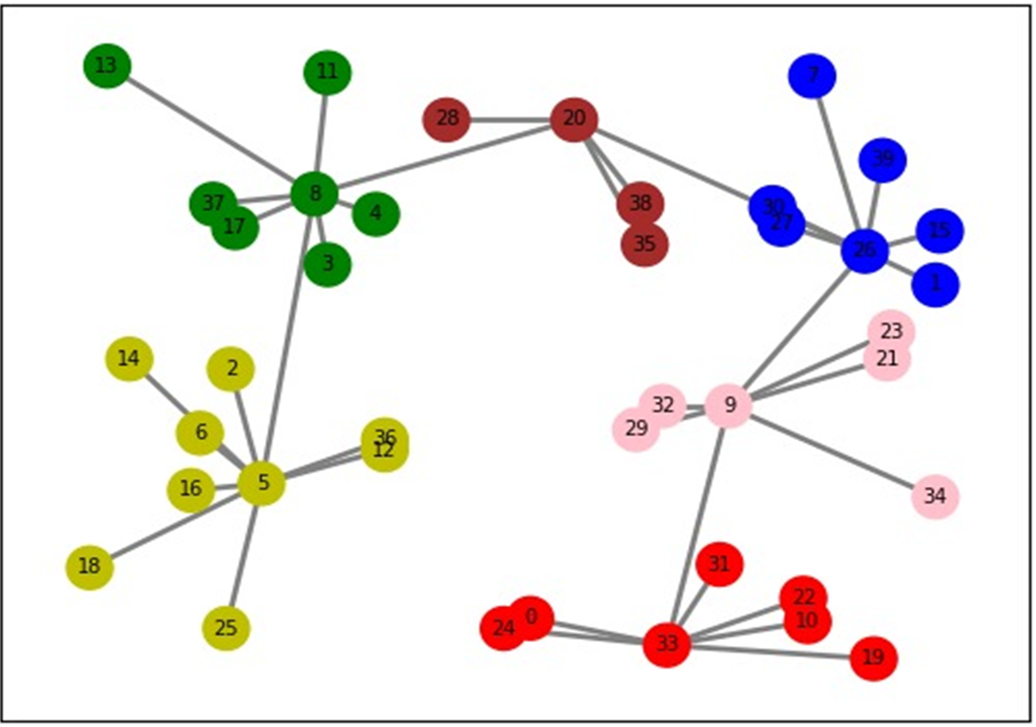
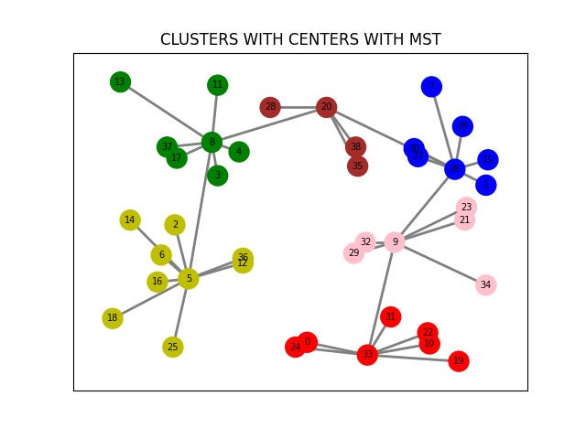
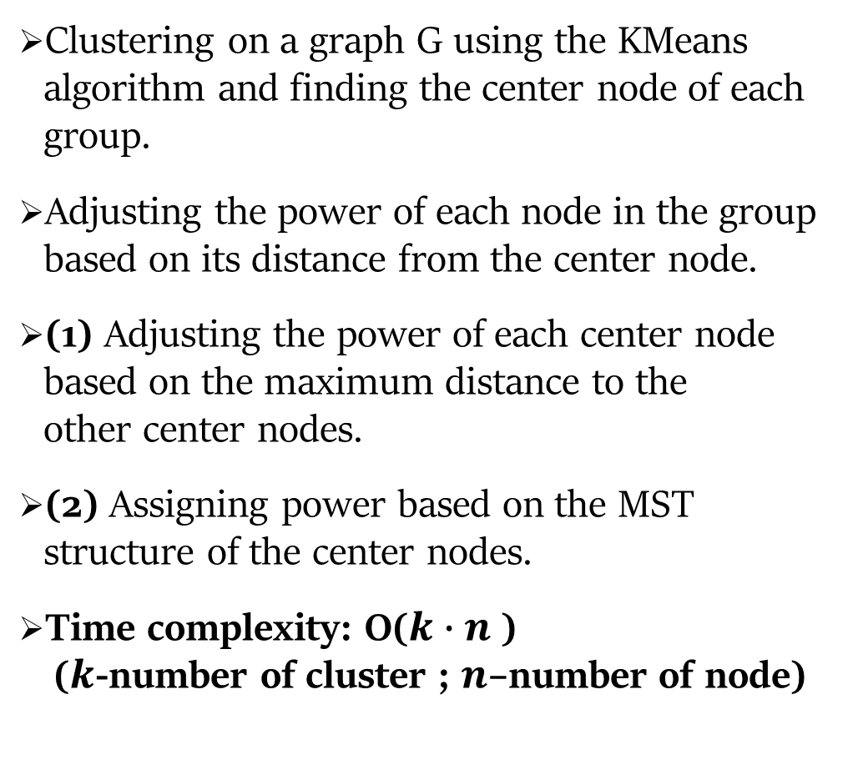
Design - method 1,2
Clustering on a graph G using the KMeans algorithm and finding the center node of each group.
Adjusting the power of each node in the group based on its distance from the center node.
(1) Adjusting the power of each center node based on the maximum distance to the other center nodes.
(2) Assigning power based on the MST structure of the center nodes.
Time complexity: O($k∙n$) ($k$-number of cluster ; $n$–number of node)

Slide 6
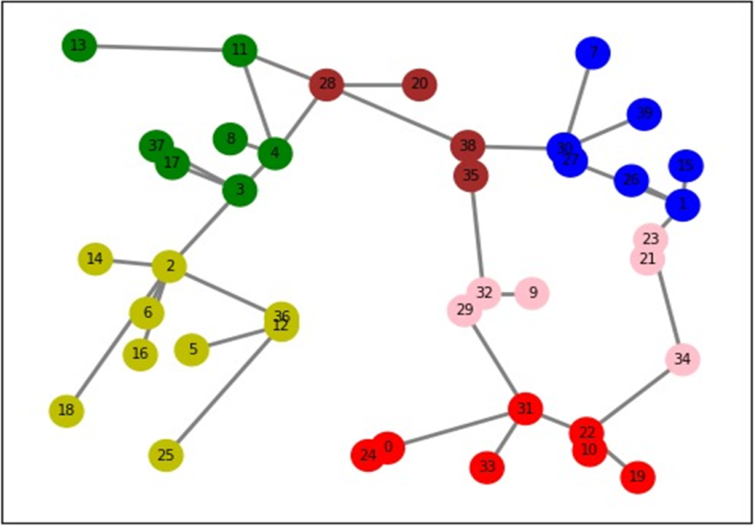
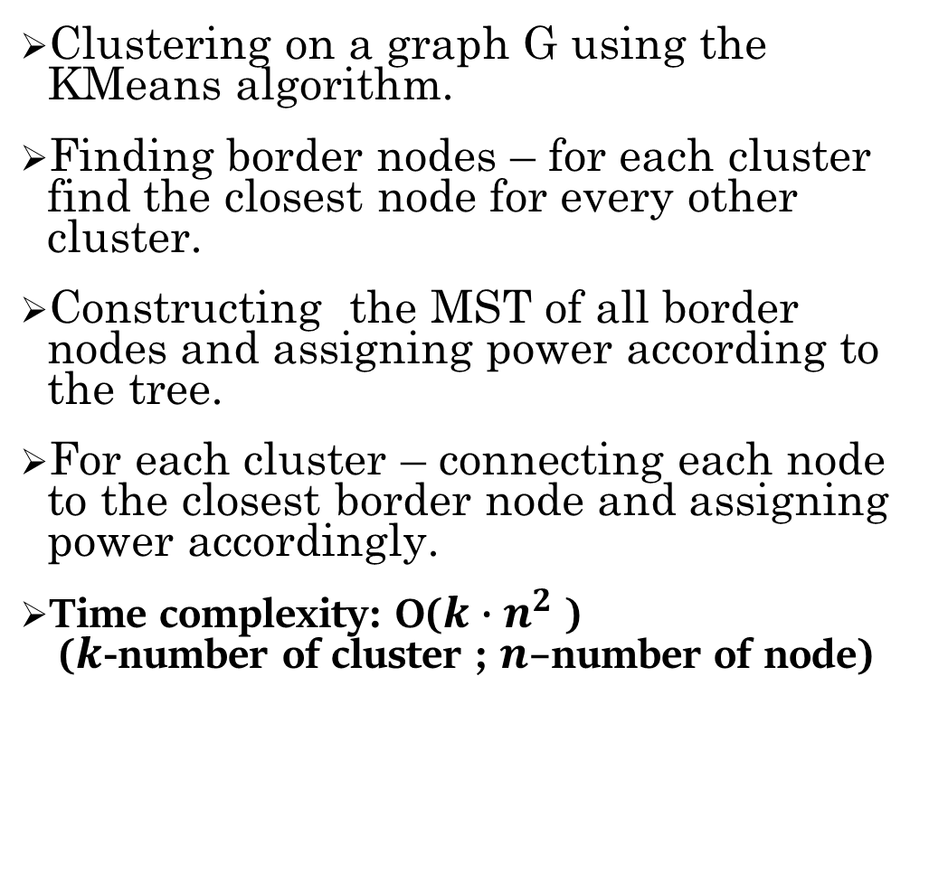
Design - method 3
Clustering on a graph G using the KMeans algorithm.
Finding border nodes – for each cluster find the closest node for every other cluster.
Constructing the MST of all border nodes and assigning power according to the tree.
For each cluster – connecting each node to the closest border node and assigning power accordingly.
Time complexity: O($k∙n^{2}$) ($k$-number of cluster ; $n$–number of node)

Slide 7
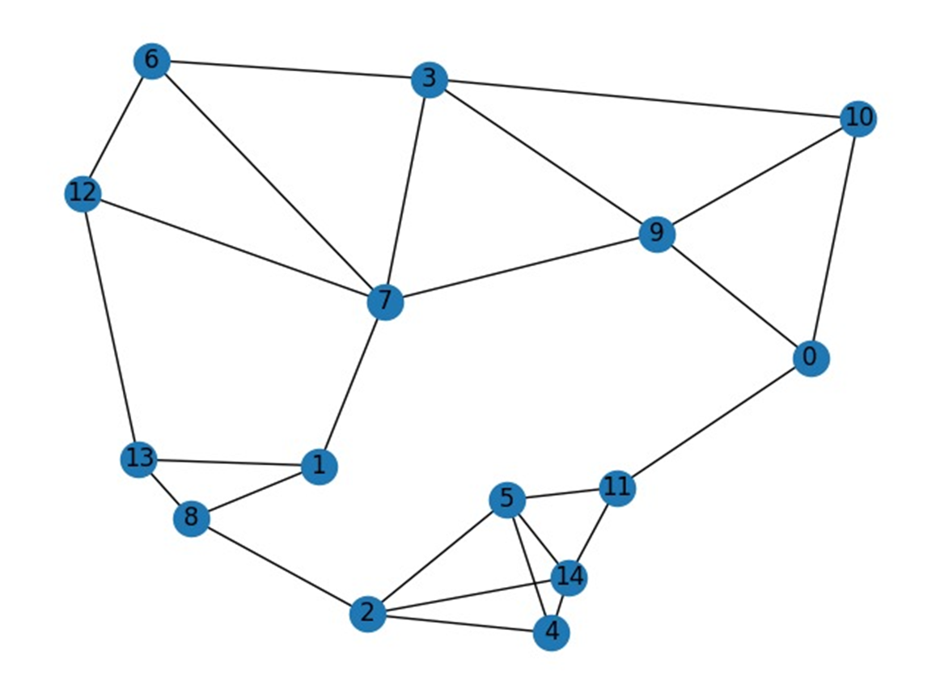
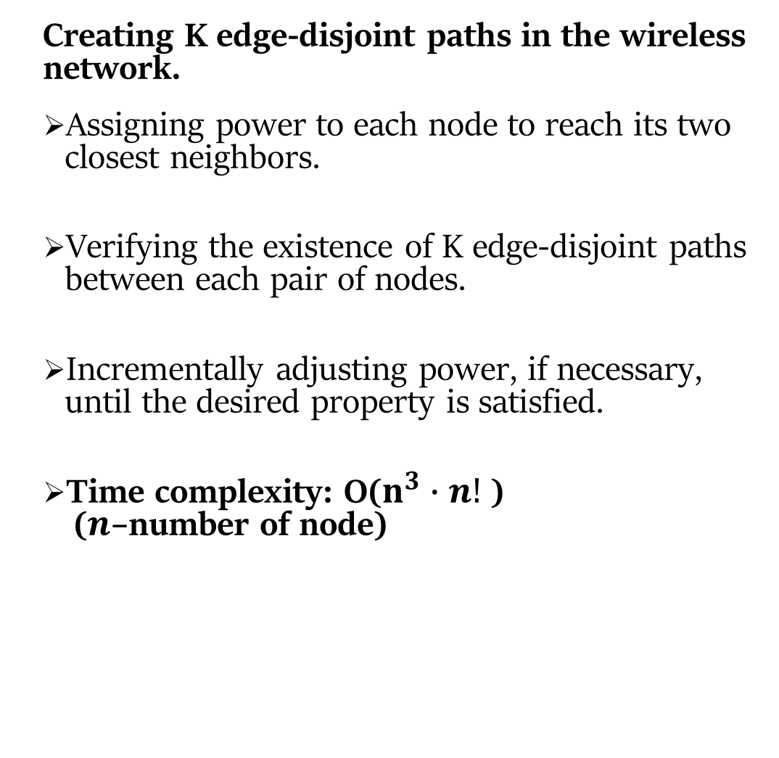
Design - method 4
Creating K edge-disjoint paths in the wireless network.
Assigning power to each node to reach its two closest neighbors.
Verifying the existence of K edge-disjoint paths between each pair of nodes.
Incrementally adjusting power, if necessary, until the desired property is satisfied.
Time complexity: O($n^{3}∙n!$) ($n$–number of node)

Slide 8

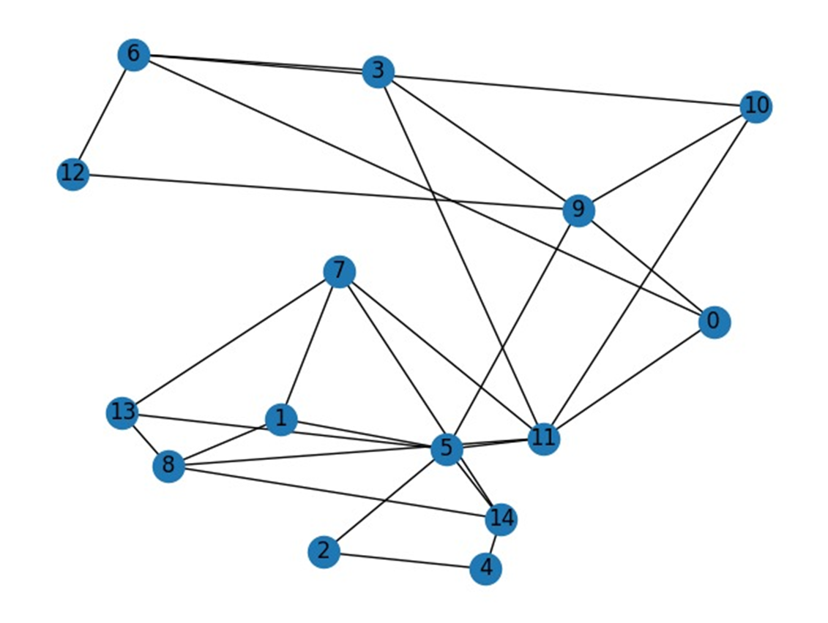
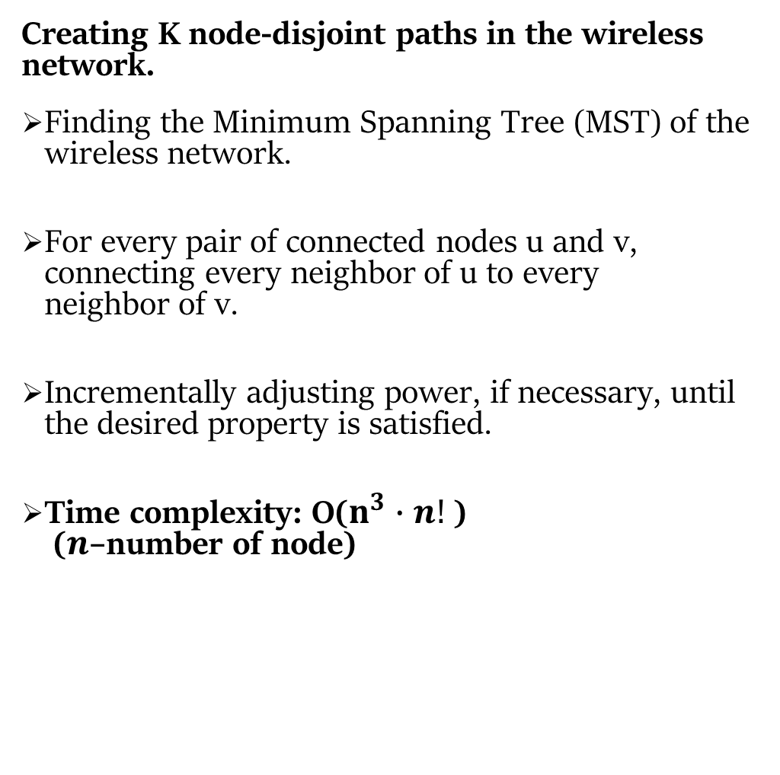
Design - method 5
Creating K node-disjoint paths in the wireless network.
Finding the Minimum Spanning Tree (MST) of the wireless network.
For every pair of connected nodes u and v, connecting every neighbor of u to every neighbor of v.
Incrementally adjusting power, if necessary, until the desired property is satisfied.
Time complexity: O($n^{3}∙n!$) ($n$–number of node)

Slide 9
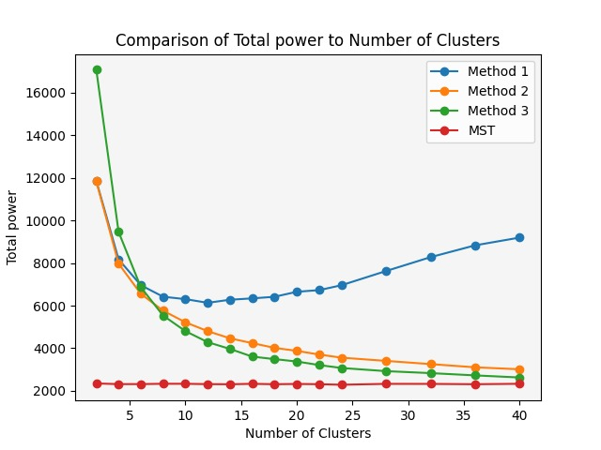
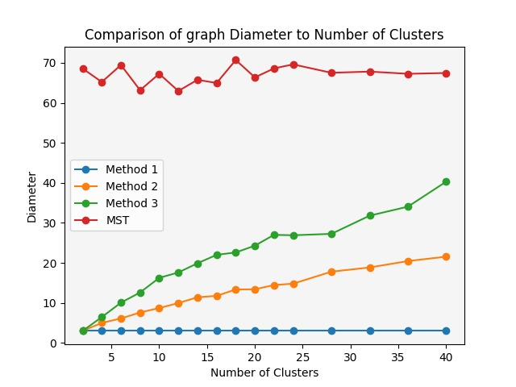
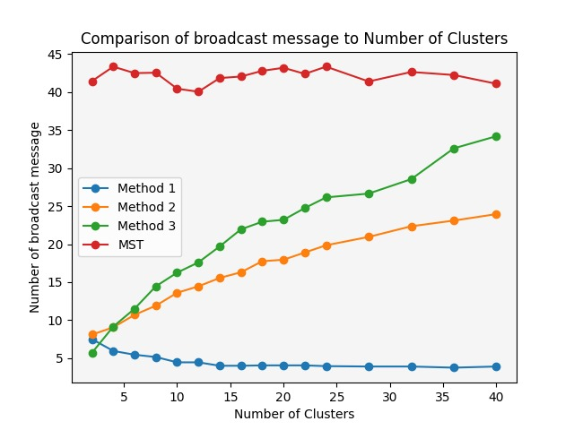
Impact of number of clusters
Experiment & Results
(1)
Impact of different number of cluster on total power.
Impact of different number of cluster on graph diameter.
Impact of different number of cluster on the number of broadcast messages that can pass through the graph.
(2)
(3)

Slide 10
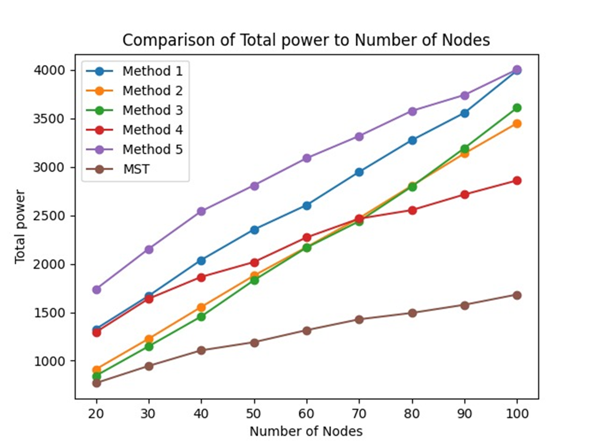
Total power vs Number of node
In small networks, Methods 2 and 3 perform closest to the optimal solution.
In large networks, Method 4 achieves the closest approximation to the optimal solution.
Method 5 trades higher power consumption for increased network durability.

Slide 11
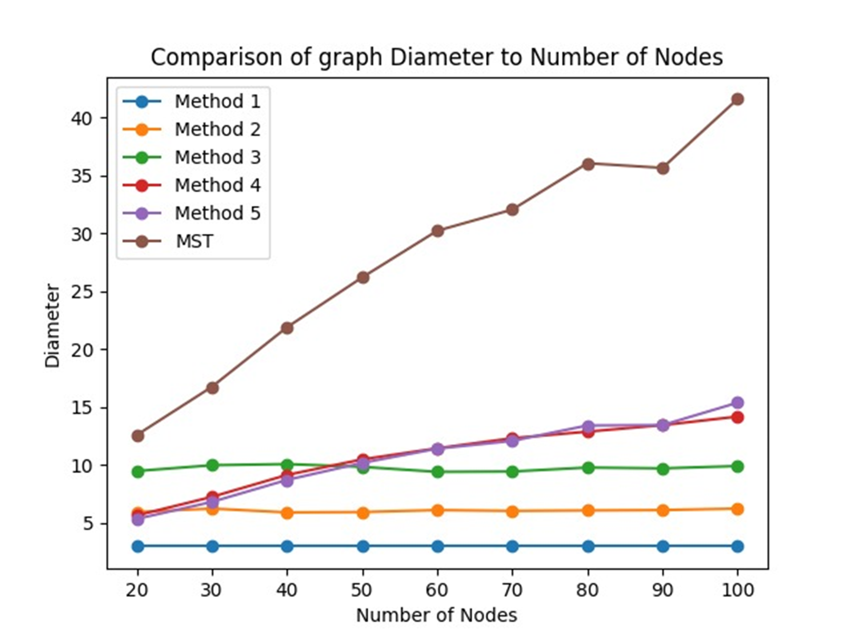
Diameter vs Number of node
In Methods 1, 2, and 3, the graph diameter is determined solely by the number of clusters and remains independent of the network size.
In Methods 4 and 5, the graph diameter increases slowly with the network size, indicating a gradual expansion relative to the network size.

Slide 12
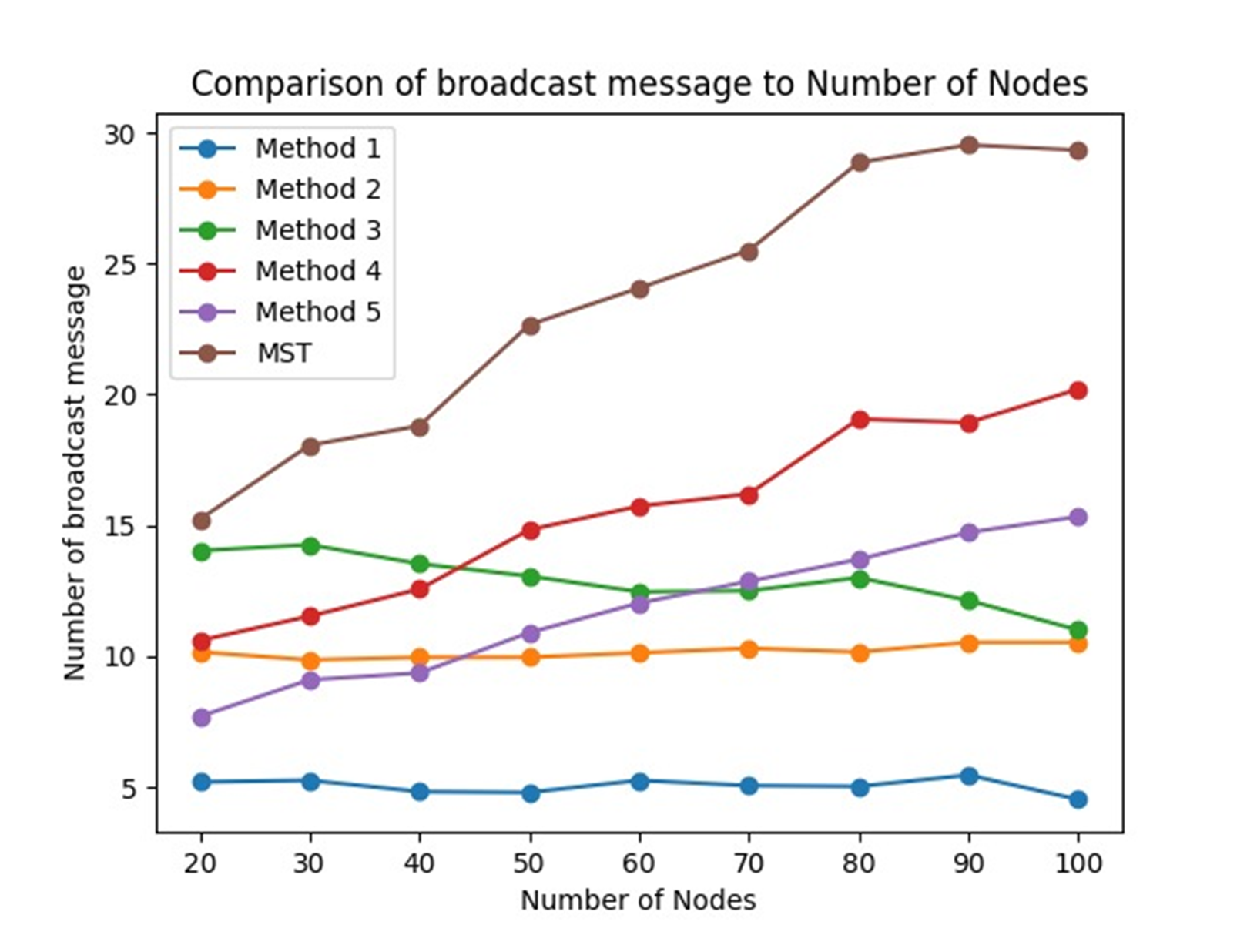
Broadcast message vs Number of node
The number of broadcast messages passing through the network represents the lifespan of the network.
In methods 1, 2, and 3, the number of broadcast messages is primarily determined by the number of clusters and remains independent of the network size.
In methods 4 and 5, the number of broadcast messages increases gradually as the network size grows.

Slide 13
Conclusion
Methods 1 and 2 exhibit the best time complexity, followed by Method 3, while Methods 4 and 5 have the poorest running times among all the methods.
Methods 1, 2, and 3 prioritize maintaining a low graph diameter.
Methods 4 and 5 emphasize extending the system's lifespan and providing resilience against computer failures.
A trade-off exists between minimizing total power consumption, maintaining a low graph diameter, and ensuring the network's resilience against node failures.

Slide 14
summery
For only minimum total power conidiation:
MST
For minimum total power conidiation & minimum graph diameter:
Method 2 (centers clique based on clustering).
Method 3 (border MST based on clustering ).
For minimum total power & given graph diameter conidiations:
Method 1 (centers MST based on clustering)
For minimum total power conidiation & fault-tolerant networks:
Method 4 (k-edge disjoint paths)
Method 5(k-node disjoint paths)

